Slide 1



SARS-Cov-2 Spike Protein Analysis using second Vassiliev Measure
iCompBio REU Summer 2021
Jason Middlebrook with mentor, Professor Eleni Panagiotou

Slide 2
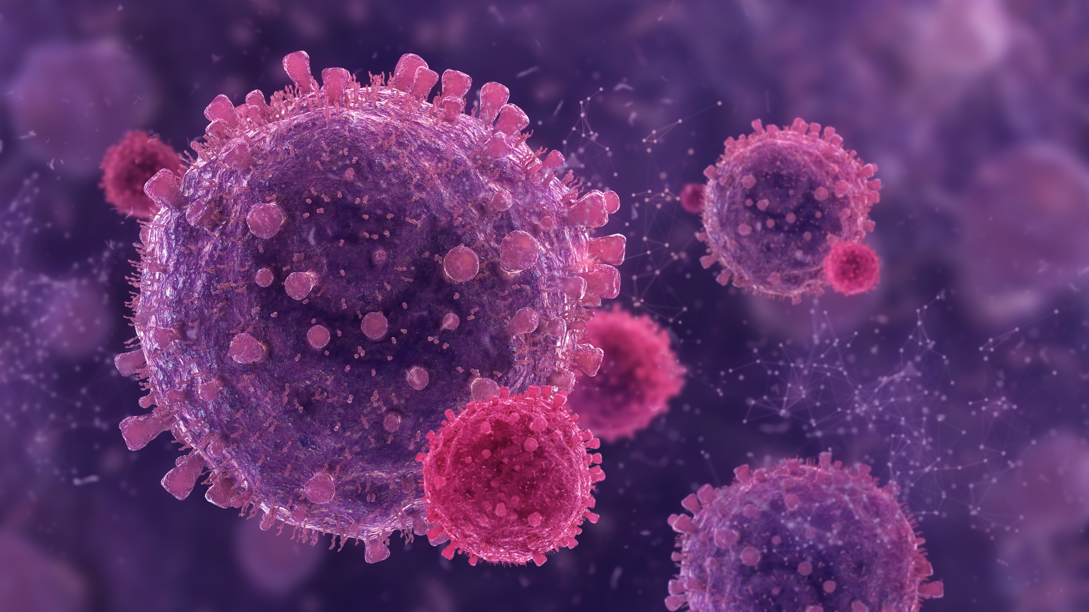
Background

Slide 3
Protein Structures – 3 types
Primary structure is protein’s amino acid sequence
Secondary structure refers to the set of 3-d shapes the protein is made up of (e.g. alpha helices, beta sheets)
Tertiary structure is the 3-d conformation of the entire chain of amino acids that makes up the protein
Recorded in PDB files

Slide 4
SARS-CoV-2 spike protein
Spike (S) protein binds to the human ACE2 receptor to infect cell
This plays a crucial role in the viral life cycle
S1 helps ACE2 binding
S2 helps fuse viral and human cell membranes

Slide 5
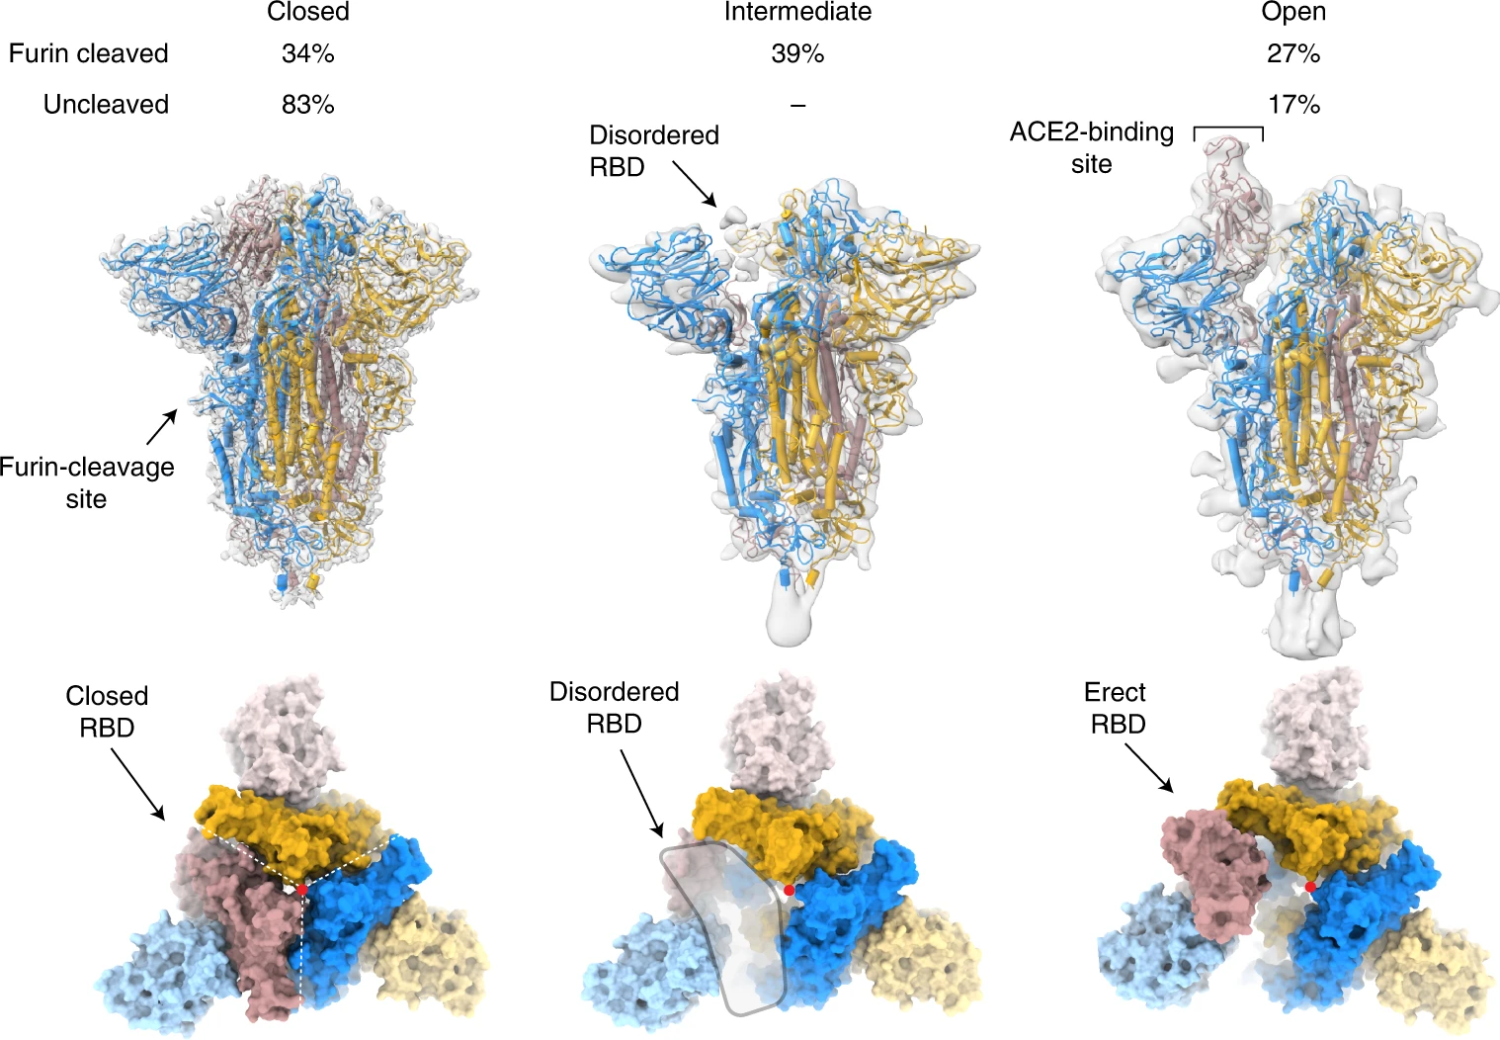
Receptor-Binding Domain (RBD) in s1
[1] figure 1

Slide 6
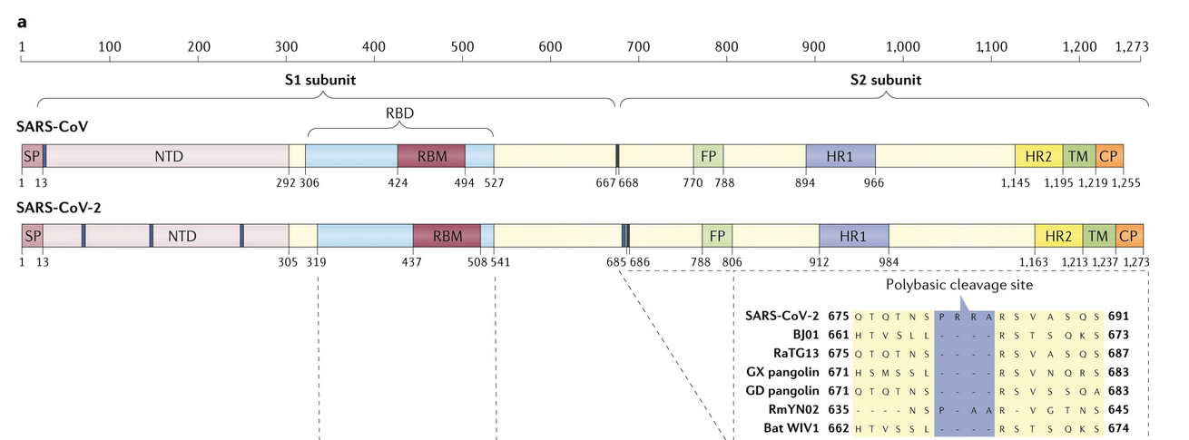
Protein Structure and Approximate Domains
Not pictured, Central Helix (CH) and Connector Domain (CD)
[4] figure 3a

Slide 7
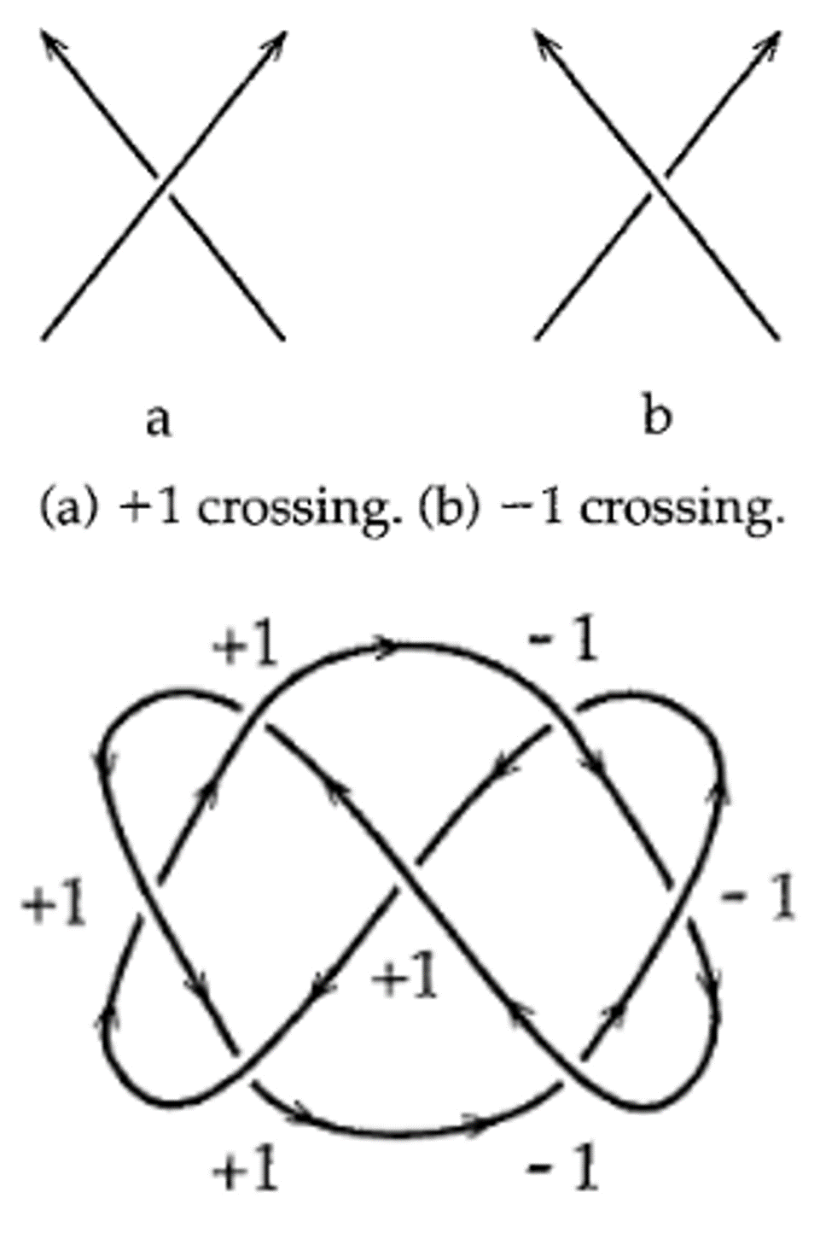
The Second Vassiliev Measure
Topology – mathematical study of knots
Second Vassiliev Measure (V2) is a topological measure for both closed and open knots
Uses crossing numbers to determine complexity of knots (and proteins)
[3] figures 6.6 and 6.7

Slide 8
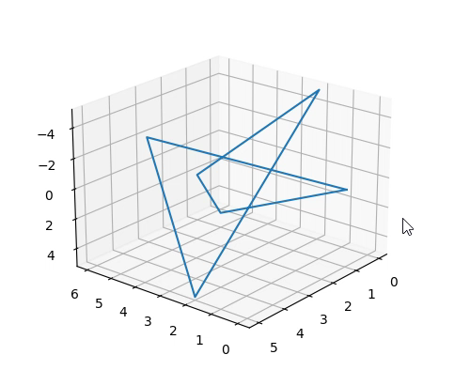
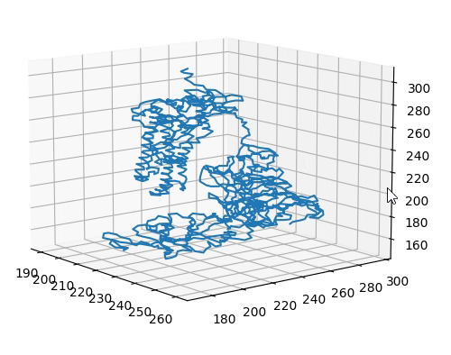
Vassiliev projections
To calculate V2 for open knots (proteins), we must use 2-d projections
We take projections onto random planes
We are looking at the protein from a random vantage point and calculating its crossings and V2 from there

Slide 9

Methods

Slide 10
Total Values Of V2 For Proteins At 100 And 1000 Projections

Slide 11
Total Values Of V2 For Proteins At 1000 And 2000 Projections

Slide 12
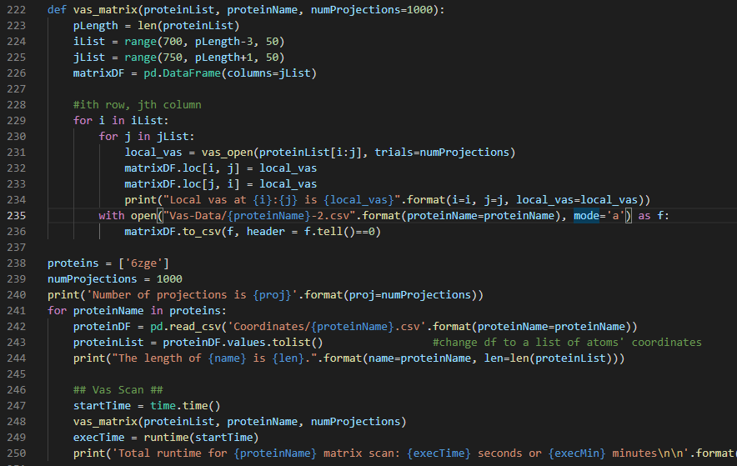
Code Example

Slide 14

Results

Slide 15
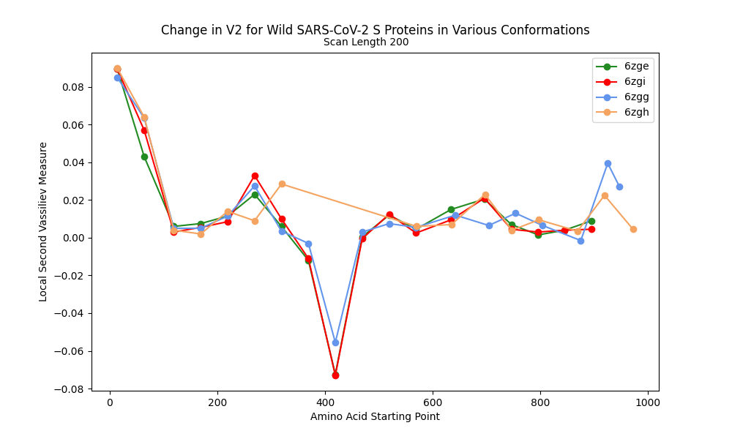
Change in V2 at 200 Scanning Length for Wild S Proteins
Dip section goes from RBD, through cleavage sites separating S1 & S2, up to the end of FP

Slide 16
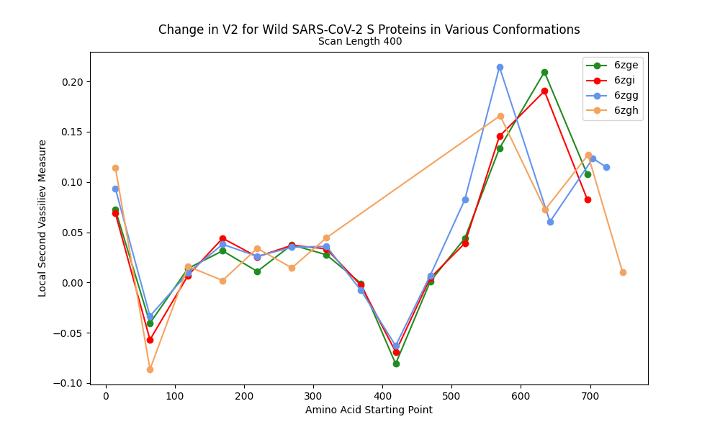
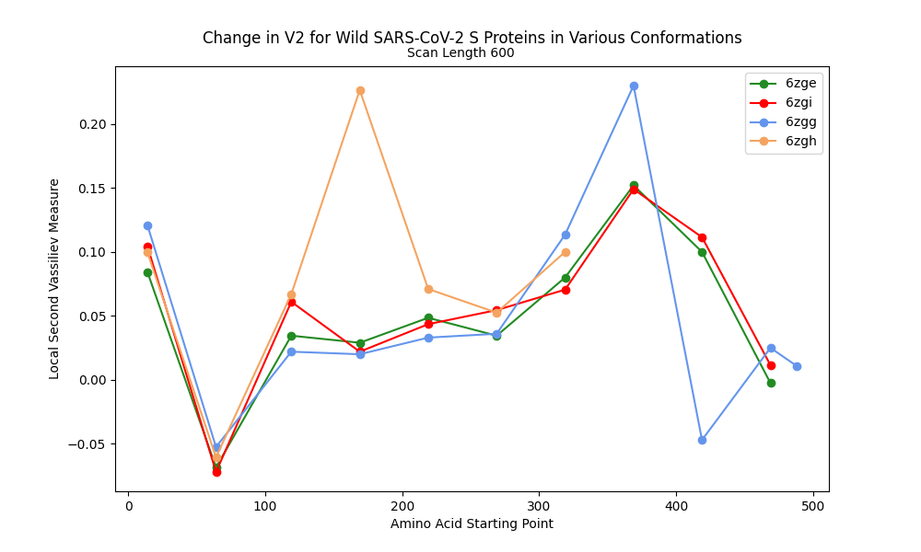
V2 along Wild SARS-CoV-2 s Proteins: 400/600 scan-lengths
First dip makes up almost all of S1

Slide 17
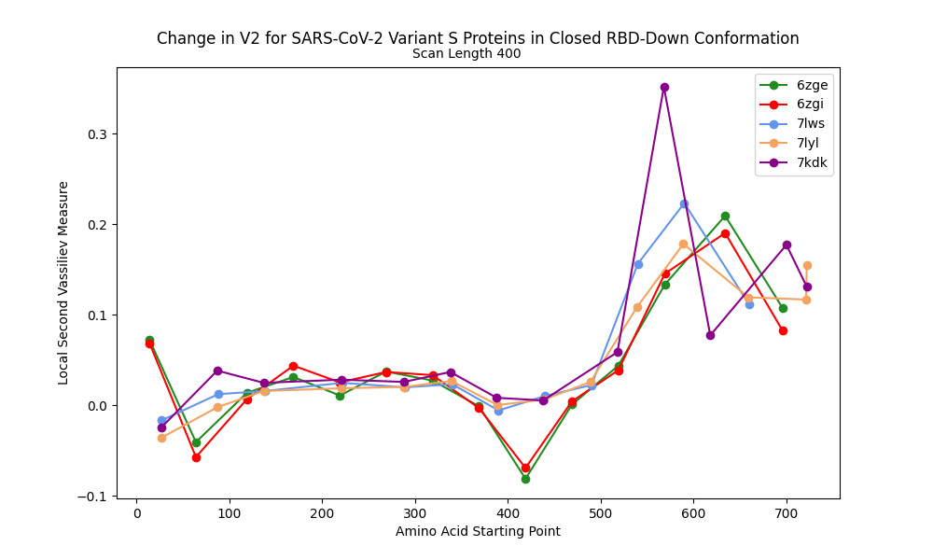
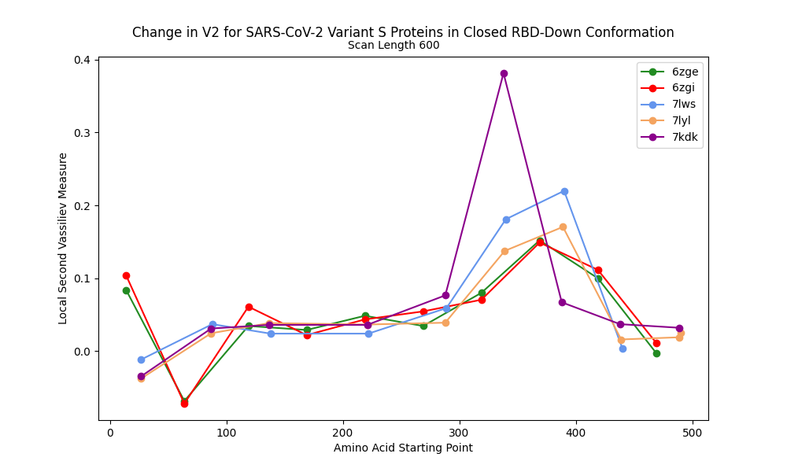
V2 along RBD-Down Proteins at 400/600 Scan-lengths
Peaks are close in magnitude, except 7kdk (D614 mutated)
Peaks are from 0.18 to 0.35
Wild (6zge and 6zgi) have smallest peak
Peaks are from 0.15 to 0.38

Slide 18
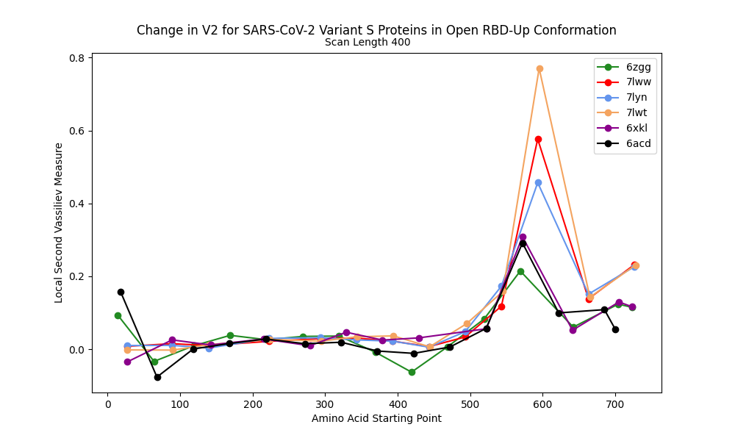
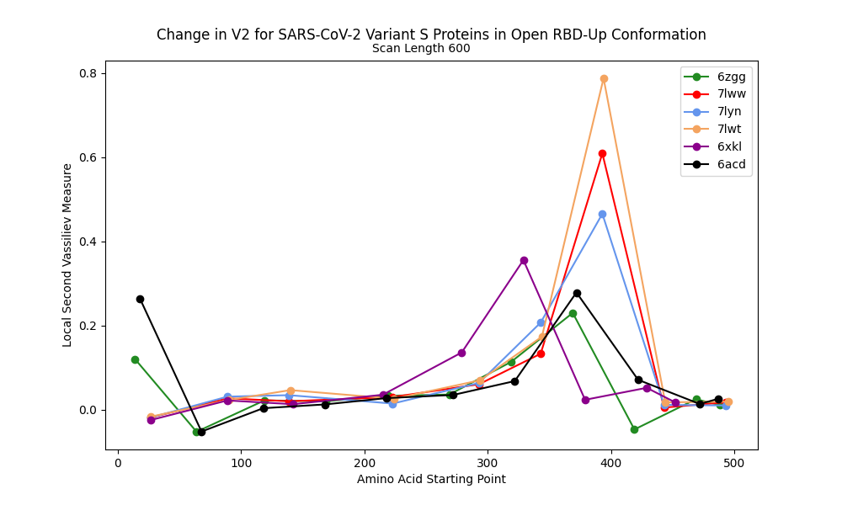
V2 along RBD-Up Proteins at 400/600 Scan-lengths
Wild (6zgg) has smallest peak, UK variant and triple mutant have tallest
Peaks are from 0.21 to 0.77
Wild (6zgg) has smallest peak, UK variant and triple mutant have tallest
Peaks are from 0.23 to 0.79

Slide 19
RBD-Down creates a tighter knot, leads to increased V2

Slide 20
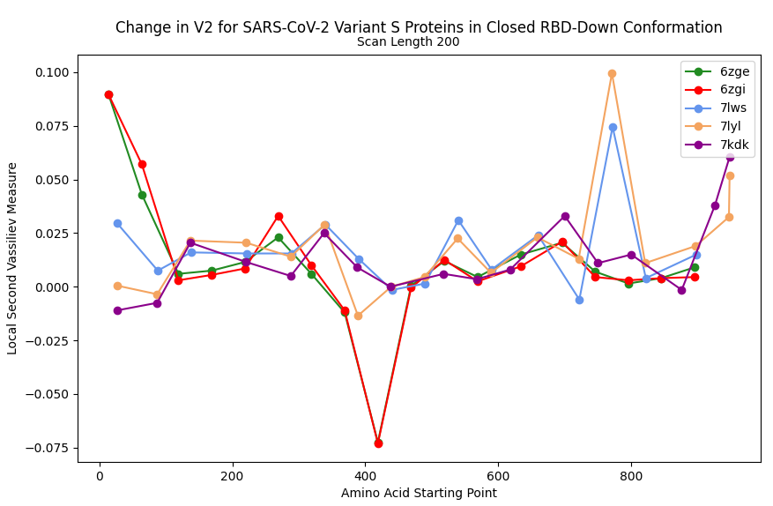
Domains at the Peak locations
Variants’ mutations might explain higher V2 at peak locations
Concentrated 780-980 segment also has peak for UK and SA variants.
The T716I mutation found in the UK variant is here, and the S982A and D1118H mutations are at domains HR1 and CD

Slide 21
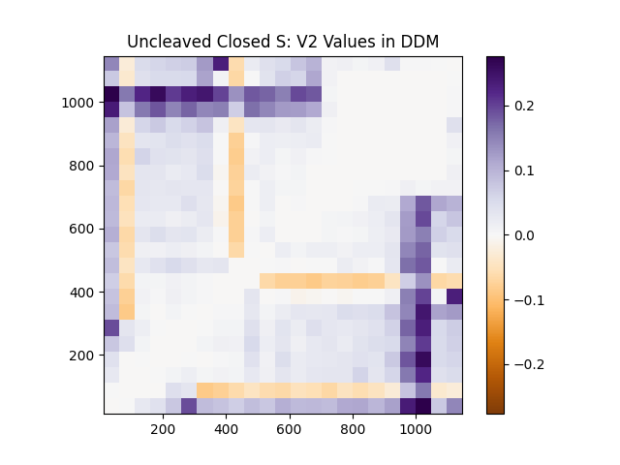

Difference Distance Matrix (DDM) for the V2 values Of The Uncleaved Closed S Protein (PDB: 6zge)
X- and Y-Axes are starting and ending amino acids (approximate locations)

Slide 22
Future Work
Create difference distance matrices for other proteins and with more thorough scanning
More comparison of mutations with changes in V2 (other proteins)
More comparison of RBD conformation with changes in V2

Slide 23


Acknowledgements
I would like to thank and acknowledge support from my mentor for the REU, Professor Eleni Panagiotou
I also acknowledge support from the NSF REU award #1852042
I would also like to thank Dr. Hong Qin and the University of Tennessee at Chattanooga.

Slide 24

THANK YOU
References:
Wrobel, A.G., Benton, D.J., Xu, P. et al. SARS-CoV-2 and bat RaTG13 spike glycoprotein structures inform on virus evolution and furin-cleavage effects. Nat Struct Mol Biol 27, (2020) 763–767.
https://cbm.msoe.edu/teachingResources/proteinStructure/primary
Adams, C.C. The Knot Book: An Elementary Introduction to the Mathematical Theory of Knots. (2004) 152.
Hu, B., Guo, H., Zhou, P. et al. Characteristics of SARS-CoV-2 and COVID-19. Nat Rev Microbiol 19, (2021) 141–154 .
github.com/MiddlebrookJF/iCompBio-Summer2021
MiddlebrookJF@gmail.com

